Slide 1


Session III
REALSOFT-ME.COM

Slide 2
At the end of this session we will be able to:
Construct responsive website layout’s
Develop an understanding of different use cases for CSS positioning and display properties and structure the layout of a web page.
-
-
Develop interactive websites and UI applications using JavaScript
Use JavaScript to control a webpage and learn what the Document Object Model (DOM) is.
Effectively create the structure of a website using semantic HTML, and style websites with CSS and responsive layouts.
The goal of this session is to equip learners with the unique skills they need to build and develop great websites and applications.

Slide 3
Objectives (Section III: JavaScript)
Develop interactive websites using JavaScript
Learn about the Document Object Model (DOM)
Query Selector, properties and methods
Use JavaScript to control a webpage
JS Events

Slide 4
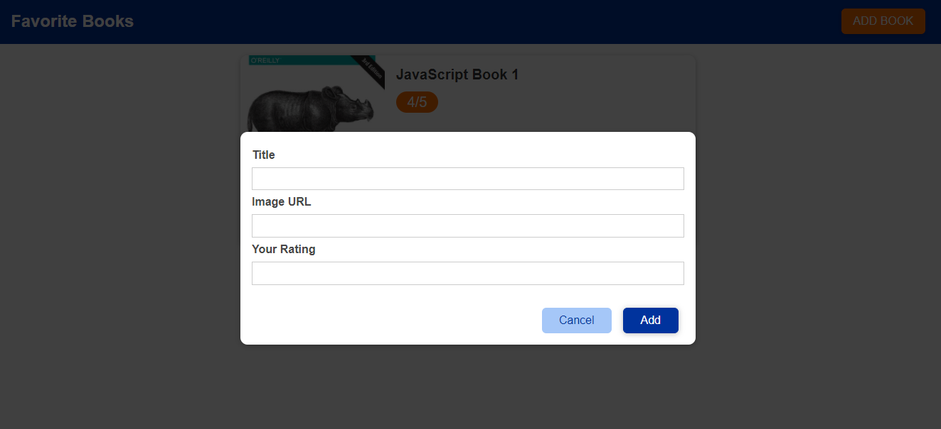
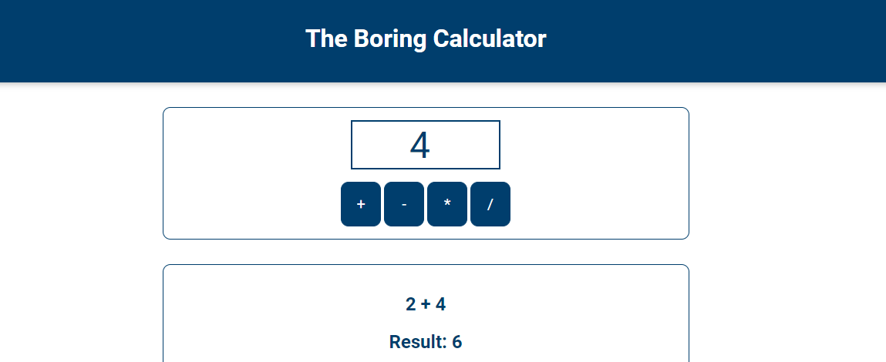
Session III
CSS
Colors
Positioning
JS
Events
Query Selectors

Slide 5

RESOURCES
Head First JavaScript (Book)
W3schools (Documentation)
https://devdocs.io/
https://developer.mozilla.org/en-US/

Slide 6

HTML is the markup language that we use to structure and give meaning to our web content, for example defining paragraphs, headings, and data tables, or embedding images and videos
CSS is a language of style rules that we use to apply styling to our HTML content, for example setting background colors and fonts, and laying out our content in multiple columns.
JavaScript is a scripting language that enables you to create dynamically updating content, control multimedia, animate images
Notes:
(HTML for content, css for style, JS for behavoiur)

Slide 7

Dynamic versus static code
The word dynamic is used to describe both client-side JavaScript, and server-side languages — it refers to the ability to update the display of a web page/app to show different things in different circumstances, generating new content as required
A web page with no dynamically updating content is referred to as static — it just shows the same content all the time.

Slide 8
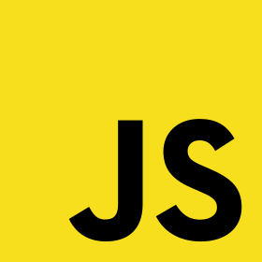
What is JavaScript?
JS improves the user experience of the web page by converting it from a static page into an interactive one.
JS adds behavior to web pages
Notes:
e.g.: stage script (if ‘x’ appears on stage, wait for 1 second, then ‘y’ appears, then x says hello, and after 1 second, ‘y’ says world)
So, the script is JS and the actors (x,y) are the html elements (unide h1, wait 1 second, unhide p, change h1 text to ‘hello’)

Slide 9

Examples & Use Cases
Change HTML content
Change HTML attribute values
Change HTML styles (CSS)
Hide/Show HTML Elements
Execute actions in response to certain events occurring
Common examples of JavaScript that you might use every day include the search box on Amazon, or refreshing your Twitter feed

Slide 10
Conclusion
JS is a web development technology, but it is so much more than that.
You can use JS to develop:
front end web applications.
back end web applications
simple browser games.
mobile apps

Slide 11

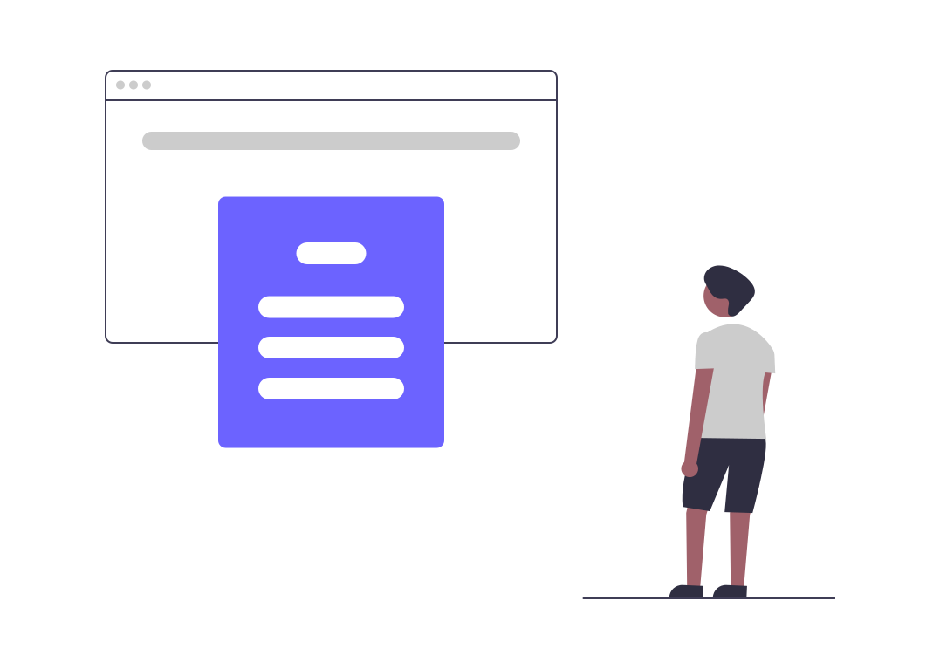
How do you add JavaScript to your page?
JavaScript is applied to your HTML page in a similar manner to CSS. Whereas CSS uses <link> elements to apply external stylesheets and <style> elements to apply internal stylesheets to HTML, JavaScript only needs one friend in the world of HTML — the <script> element

Slide 12

DOM
It represents the page so that programs can change the document structure, style, and content.
The DOM represents the document as nodes and objects. That way, programming languages (JS) can connect to the page (access it) and change all the elements of an HTML document.
Notes:
When a web page is loaded, the browser creates a Document Object Model of the page.
The HTML DOM model is constructed as a tree of Objects:

Slide 13

JavaScript gets all the power it needs to create dynamic HTML:
Change all the HTML elements, attributes and CSS styles in the page.
Remove existing HTML elements and attributes.
Add new HTML elements and attributes

Slide 14


Slide 15

Getting Started
Playing around with any webpage
Change Title
Change background color
Change all paragraphs colors
Notes:
Change the title:
document.title -> prints the title
document.title = "Name"
---------------------------------
change background:
document.body.style.backgrondColor = 'red’
---------------------------------
Change all paragraphs background colors
list = document.querySelectorAll('p’)
list.forEach( (li) => li.style.backgroundColor = 'red')

Slide 16
Quick Example
<html> <body> <p id="demo"></p> <script> const p = document.getElementById("demo")
p.innerHTML = "Hello World!"; </script> </body> </html>
The getElementById Method
The most common way to access an HTML element is to use the id of the element. getElementById method used id="demo" to find the element.
The innerHTML Property
The easiest way to get the content of an element is by using the innerHTML property.
Notes:
The HTML DOM can be accessed with JavaScript (and with other programming languages)
getElementById is a method, while innerHTML is a property.
A property is a value that you can get or set (like changing the content of an HTML element).
A method is an action you can do (like add or deleting an HTML element).
The innerHTML property is useful for getting or replacing the content of HTML elements.

Slide 17

Variables
Constants
Functions
Notes:
+ String Operations

Slide 18
Variables
Variables are used whenever there’s a need to store a piece of data. A variable contains data that can be used in the program elsewhere.
Using variables also ensures code re-usability since it can be used to replace the same value in multiple places.
Notes:
A variable is a container for data that is stored in computer memory. It is referenced by a descriptive name that a programmer can call to assign a specific value and retrieve it.
An assignment operator assigns a value to its left operand based on the value of its right operand.

Slide 19
Strings
Strings are any grouping of characters (letters, spaces, numbers, or symbols) surrounded by single quotes ' or double quotes "
String interpolation is the process of evaluating string literals containing one or more placeholders (expressions, variables, etc).
Template literals are strings that allow embedded expressions.
Notes:
The .length property of a string returns the number of characters that make up the string
==========================================================
let age = 7; // String concatenation 'Tommy is ' + age + ' years old.'; // String interpolation `Tommy is ${age} years old.`;
//https://javascriptguide.herokuapp.com/

Slide 20
Functions
A function is a block of code designed to perform a particular task.
Why Functions?
You can reuse code: Define the code once and use it many times.
You can use the same code many times with different arguments, to produce different results
Functions can be used the same way as you use variables, in all types of formulas, assignments, and calculations.
Notes:
Animal verbs: jump() eat() sit()
Browser verbs: alert()
Functions are “code on demand”

Slide 21

Functions
Define a function:
parameters are optional
returning values is also optional
Calling a function
Returning values
Functions often compute a return value.
The return value is "returned" back to the "caller“
When JavaScript reaches a return statement, the function will stop executing.
Notes:
Teach browsers your own verbs by defining a new function
function greet(){
alert('Hello, My name is Yaman’)
}
//MAKE IT FLEXIBLE (ADD PARAMETERS)
function greetUser(name){alert(‘Hello ’ + name);}
--------------------------
function that returns a value:
function triple()

Slide 22
Read about…
Anonymous Functions
Higher Order Functions
Callback Functions
Notes:
higher-order functions:
- accepts a function as an argument
returns a function
https://jstutorial.medium.com/higher-order-functions-in-javascript-732dc7a1952d
------------------------------------
A callback function is a function that’s passed as an argument to another function
Imagine you have FunctionA which gets passed as an argument to FunctionB. FunctionB will do some work and then call FunctionA at some point in the future
This function can then be invoked during the execution of that higher order function (that it is an argument of).
-----------------------------------
Arrow functions don’t bind their own this value. Instead, the this value of the scope in which it was defined is accessible.
This makes arrow functions bad candidates for methods, as this won’t be a reference to the object the method is defined on.
const event = { name: 'Birthday Party', guestList: ['Andrew', 'Jen', 'Mike'], printGuestList() { console.log('Guest list for ' + this.name) this.guestList.forEach((guest) => { console.log(guest + ' is attending ' + this.name) }) } } event.printGuestList()

Slide 23
JS Objects
Arrays
More …
Notes:
An object is a built-in data type for storing key-value pairs. Data inside objects are unordered, and the values can be of any type
why use objects?
- Organize data as real-life objects
let car = {
make: ''
model: ''
drive() {
alert('driving') }
}
car.make = ‘aaa’
An approach, a way of writing and structuring your code
A way of thinking or planning your code.
The idea behind OOP is working with real life entities
// https://javascriptguide.herokuapp.com/

Slide 24
Arrays: Collection of items e.g.: array of posts, array of tweets, array of salaries
.length
.push()
.pop()
.unshift()
.shift()
splice()
.forEach()
.filter()
.map()
https://developer.mozilla.org/en-US/docs/Web/JavaScript/Reference/Global_Objects/Array
Notes:
let fruits = ['Apple', 'Banana’]
console.log(fruits.length)
let first = fruits[0] // Apple
let last = fruits[fruits.length - 1] // Banana
---------------------------------------
posts = [{userName: 'aaa' , post: 'bbb' , date: '22/12/2020' , id: 'post_001’}]
posts.push( { } )
-----------------------------------------
posts.splice(indexOfPost, howManyPostsToRemove)
------------------------------------------
fruits.forEach(function(item, index, array) { console.log(item, index) })
----------------
posts.forEach(printName)
const printName = (postObject) => {console.log(postObject.userName) }
-----------------
Filter -> list incompleted tasks only
The filter() method creates a new array with array elements that passes a test
arr = [1,3,7,8]
const filteredArray = arr.filter( (price) => {
return price > 6; } );
// filteredArray will store [7,8]
--------------
var numbers = [45, 4, 9, 16, 25];
var over18 = numbers.filter(myFunction);
function myFunction(value, index, array) {
return value > 18;
}
----------
The find() method returns the value of the first element in an array that pass a test (provided as a function).
The find() method executes the function once for each element present in the array:
If it finds an array element where the function returns a true value, find() returns the value of that array element (and does not check the remaining values)
Otherwise it returns undefined
ages.find( (age) => {
return age >= 10;
});
or:
array1.find(element => element > 10)
If you need the index of the found element in the array, use findIndex().
to find objects:
const inventory = [
{name: 'apples', quantity: 2},
{name: 'bananas', quantity: 0},
{name: 'cherries', quantity: 5}
];
const result = inventory.find( ({ name }) => name === 'cherries' );
console.log(result) // { name: 'cherries', quantity: 5 }
-----------------
arr.indexOf(2.11) //Returns the first index of the element '2.11'
arr.lastIndexOf(2.11) //Returns the last index of the element '2.11'

Slide 25
Splice
The first parameter defines the position where new elements should be added (spliced in).
The second parameter defines how many elements should be removed.
The rest of the parameters define the new elements to be added.
The splice() method returns an array with the deleted items
Notes:
adding elements between elements:
arr.splice(1,0,'New String') //At index 1, delete 0 elements, add 'New String'
deleting elements:
arr.splice(1,1) //Start at index 1, delete 1 item
delete all elements starting from:
arr.splice(2) //Delete everthing past 2 (including 2)
arr.splice(-1, 1) // -1 means start at the last index (access array from the right)

Slide 26
Finding HTML Elements
document.getElementById(id) | Find an element by element id
document.getElementsByTagName(name) | Find elements by tag name
document.getElementsByClassName(name) | Find elements by class name
Notes:
The HTML DOM can be accessed with JavaScript (and with other programming languages)
getElementById is a method, while innerHTML is a property.
A property is a value that you can get or set (like changing the content of an HTML element).
A method is an action you can do (like add or deleting an HTML element).
The innerHTML property is useful for getting or replacing the content of HTML elements.

Slide 27
element.innerHTML = ’new html content’ | Change the inner HTML of an element
element.attribute = new value | Change the attribute value of an HTML element
element.style.property = new style | Change the style of an HTML element
element.setAttribute(attribute, value) | Change the attribute value of an HTML element

Slide 28
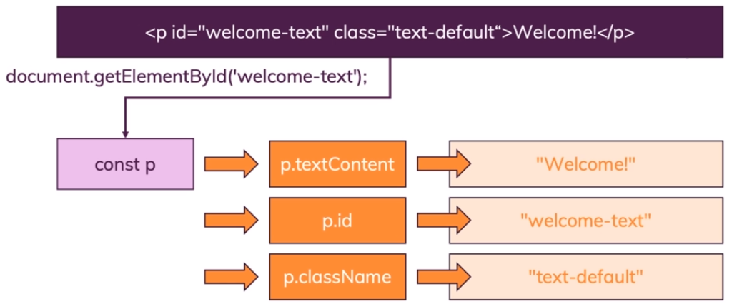

Slide 29


Slide 30
document.querySelector(selectors);
The Document method querySelector() returns the first Element within the document that matches the specified selector.
If no matches are found, null is returned.
element = document.querySelector(selectors);
Selectors: this string must be a valid CSS selector string
if it isn't, a SYNTAX_ERR exception is thrown.
Notes:
The selector methods accept one or more comma-separated selectors to determine what element or elements should be returned. For example, to select all paragraph (p) elements in a document whose CSS class is either warning or note, you can do the following:
var special = document.querySelectorAll( "p.warning, p.note" );

Slide 31
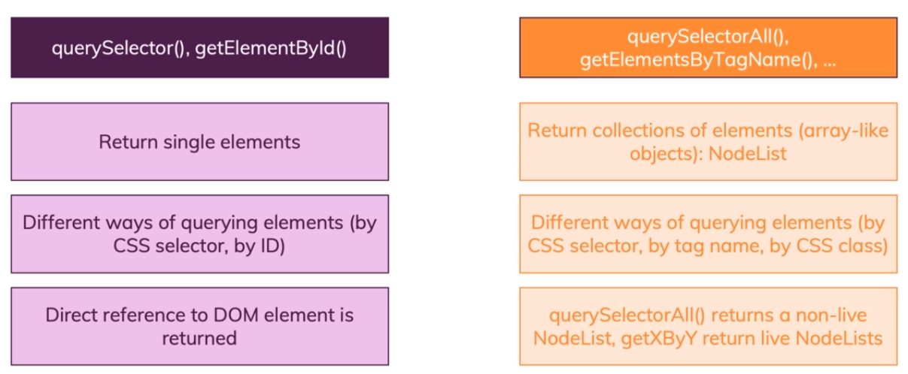

Slide 32
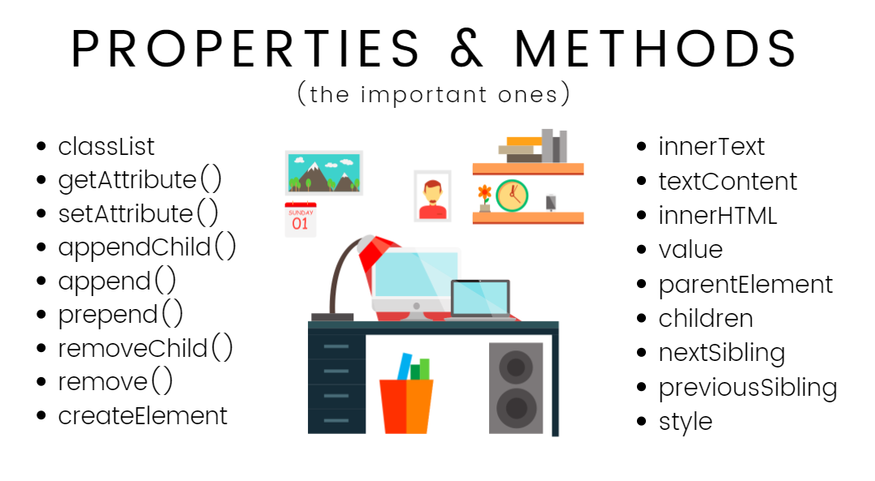

Slide 33
Change CSS properties
Change CSS properties from JavaScript by adding or removing a predefined class
document.querySelector('button').classList.add('className’)
.remove
.toggle

Slide 34
Get Inner HTML / Text
document.querySelector('h1').innerHTML;
-> returns all html inside the tag (e.g. "<strong>Hello</Strong>")
document.querySelector('h1').textContent;
-> returns the text only (e.g. "Hello")

Slide 35
https://developer.mozilla.org/enUS/docs/Web/API/Element/insertAdjacentHTML
Notes:
$('h1').text('Changed')
$('h1').html('<em>Changed<em>’)
$('h1').addClass('className1 className2')
$('h1').removeClass('className')
$('h1').hasClass('className’)
$('h2').on('mouseover', function(){ $('h2').css('color', 'purple');} )
$('input').after("<button> ADDED AFTER input </button>")
$('input').before("<button> ADDED BEFORE input </button>")
$(‘div').prepend("<button> ADDED </button>") //Inserts the element inside the div as the first child of each element in the collection
$(‘div').append("<button> ADDED </button>") // last child

Slide 36
Events are actions or occurrences that happen in the system you are programming, which the system tells you about so you can respond to the min some way if desired.
For example, if the user selects a button on a webpage, you might want to respond to that action by displaying an information box

Slide 37
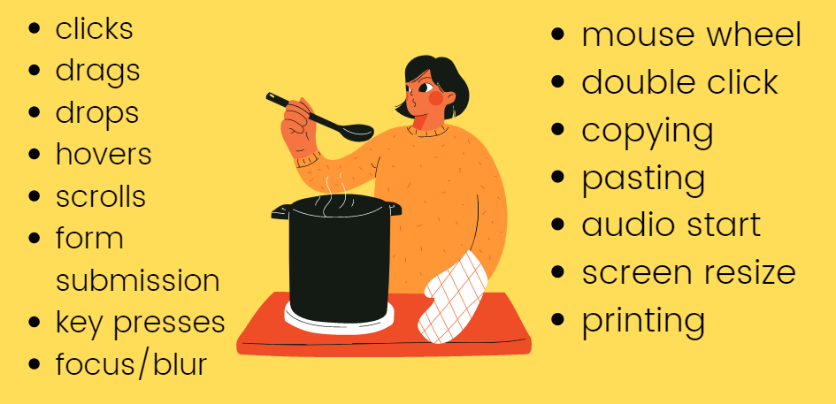
Events
Notes:
There are many different typesof events that can occur in your browser.
•The user selects a certain element or hovers the cursor over a certain element.
•The user chooses a key on the keyboard.
•The user resizes or closes the browser window.
•A web page finishes loading.
•A form is submitted.
•A video is played, paused, or finishes.
•An error occurs.

Slide 38
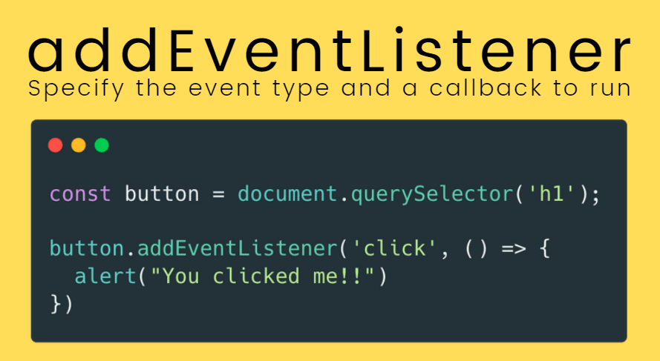
Notes:
Each available event has an event handler, which is a block of code (written by the programmer) that runs when the event fires.
When such a block of code is defined to run in response to an event, we say we are registering an event handler.
Inside the addEventListener() function, we specify two parameters: the name of the event we want to register this handler for, and the code that comprises the handler function we want to run in response to it.
https://codepen.io/raggafra/pen/zYompqm

Slide 39
Callback Function
You can’t know when a user is going to click a button, so what you do is, you define an event handler for the click event.
This event handler accepts a function, which will be called when the event is triggered.
document.getElementById('button').addEventListener('click', () => {
//item clicked })
A callback is a simple function that’s passed as a value to another function, and will only be executed when the event happens
Notes:
A callback function is a function that’s passed as an argument to another function
We can do this because JavaScript has first-class functions, which can be assigned to variables and passed around to other functions
One common example is by using timers:
setTimeout(() => { // runs after 2 seconds }, 2000)

Slide 40
Server-side versus client-side code
Client-side code is code that is run on the user's computer — when a web page is viewed, the page's client-side code is downloaded, then run and displayed by the browser.
In this session we are explicitly talking about client-side JavaScript.
Server-side code on the other hand is run on the server, then its results are downloaded and displayed in the browser.
Examples of popular server-side web languages include PHP, Python, Ruby, ASP.NET and... JavaScript! JavaScript can also be used as a server-side language, for example in the popular Node.js environment

Slide 41
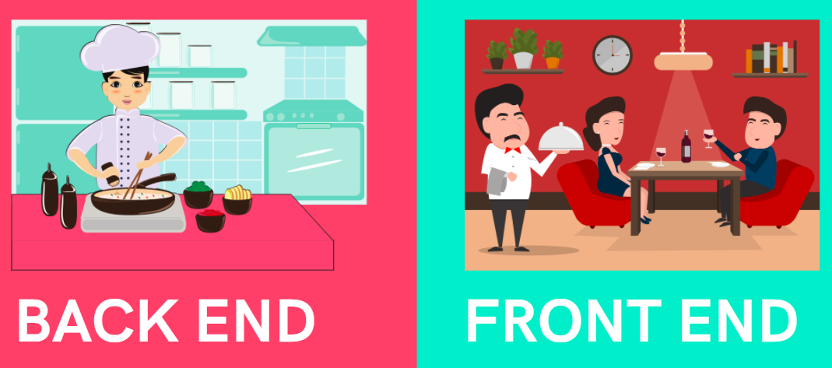

Slide 42
Utilities
VS CODE EXTENSIONS
Material Icons
Chrome Debugger

